Slide 1
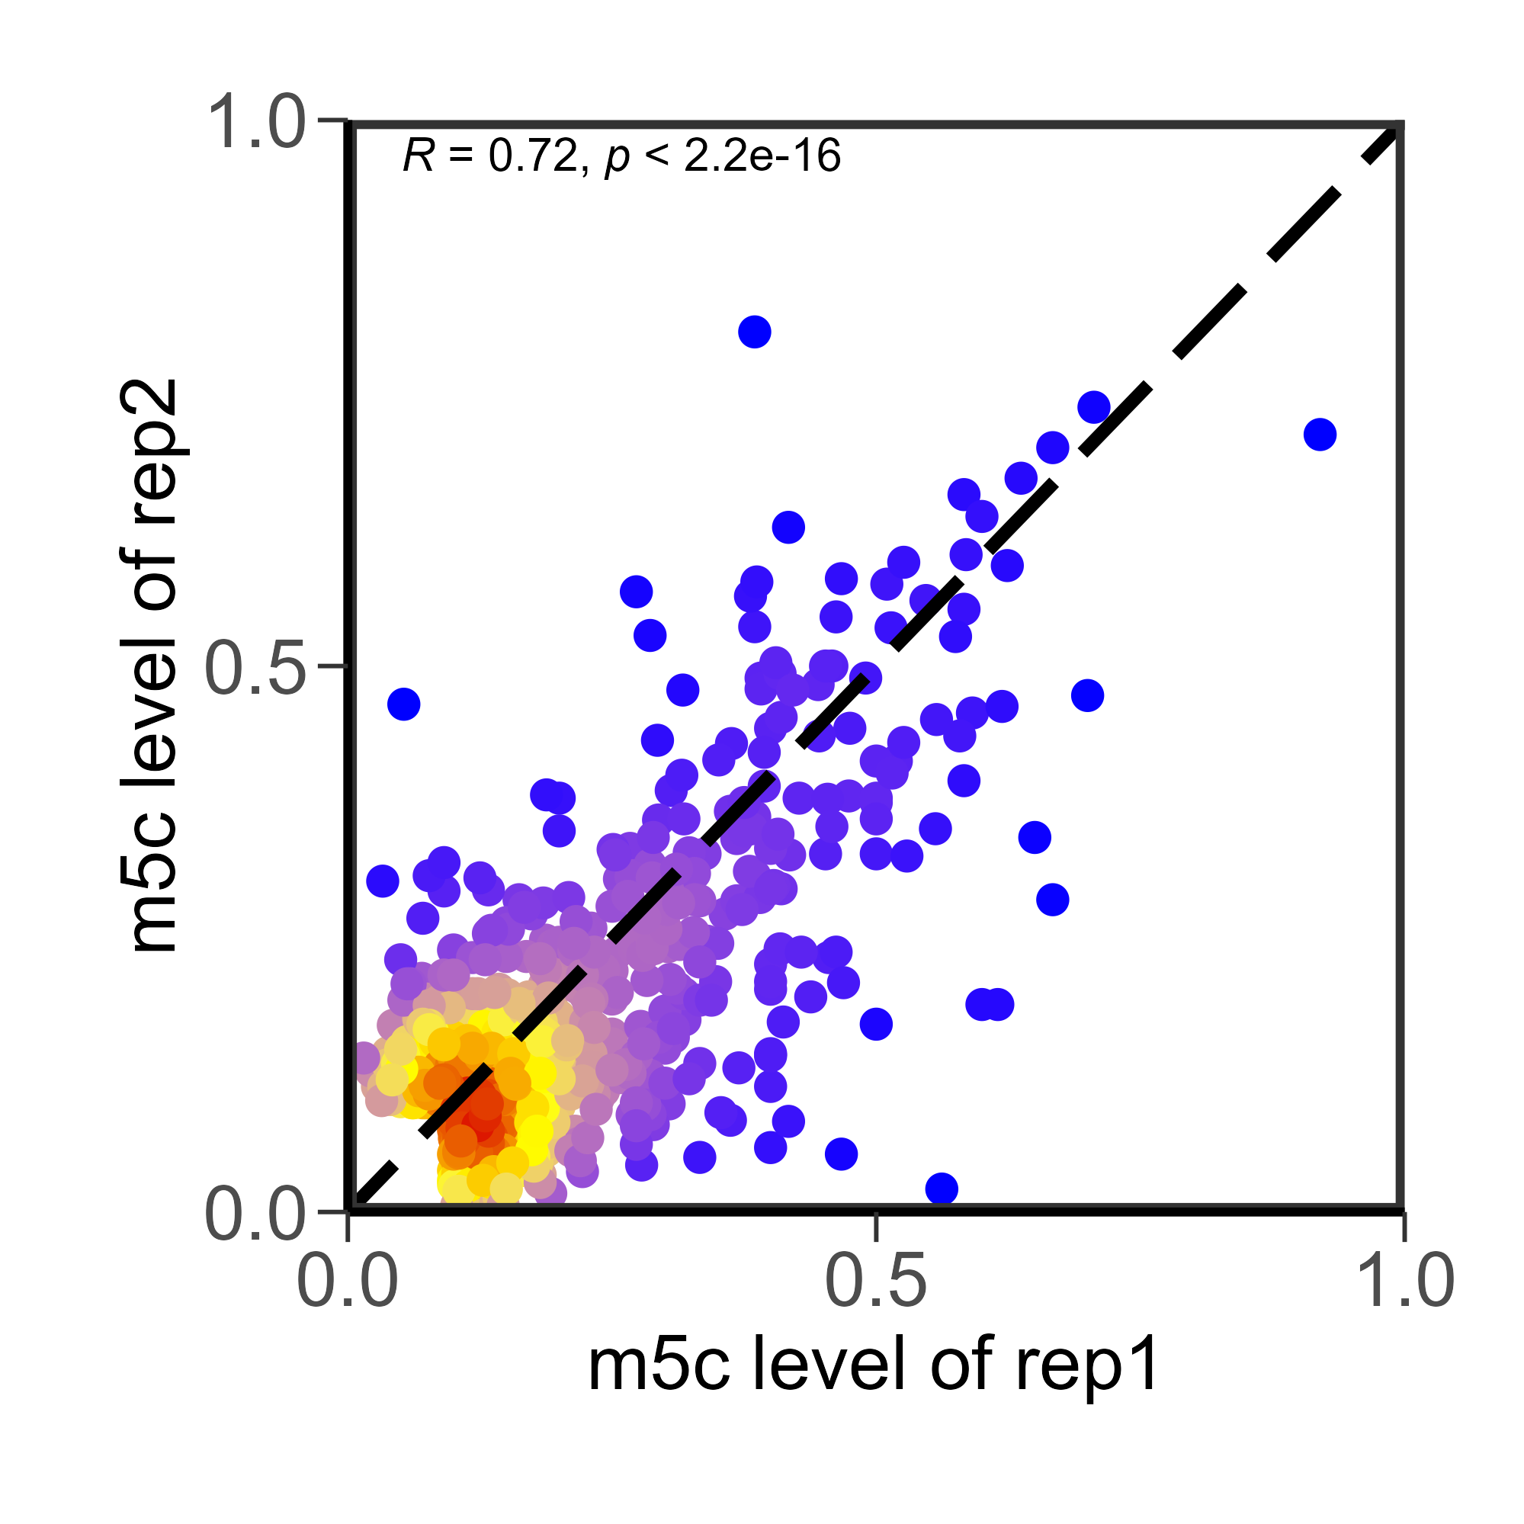
A
B
Huang libraries
Huang rep1 v rep2
Rep 2
Rep 3
Rep 1
207
160
Rep 4
40
19
39
294
155
20
273
788
21
56
20
35
22
Supplementary Figure 12. (A) Site overlap positions of all bisulfite-converted libraries used in this study. (B) Correlation plots of sites present in at least one replicate. Huang replicates 1 and 2 are used as representative samples. Spearman’s R value is shown. Points are colored according to density (red: high density, blue: low density).

